Slide 1


UK Used Car Price Prediction
Yang Zheng
October 17th, 2022
Data Science Initiative
Github Repository:
Notes:
Good morning everyone, my name is Yang Zheng, Im here to present my data1030 project. The tile of my project is UK used car price prediction.

Slide 2
CONTENTS
PART 01
PART 02
Introduction
EDA
PART 03
PART 04
Splitting
Preprocessing
Notes:
My presentation contains four parts, intro, EDA, splitting and preprocessing.

Slide 3
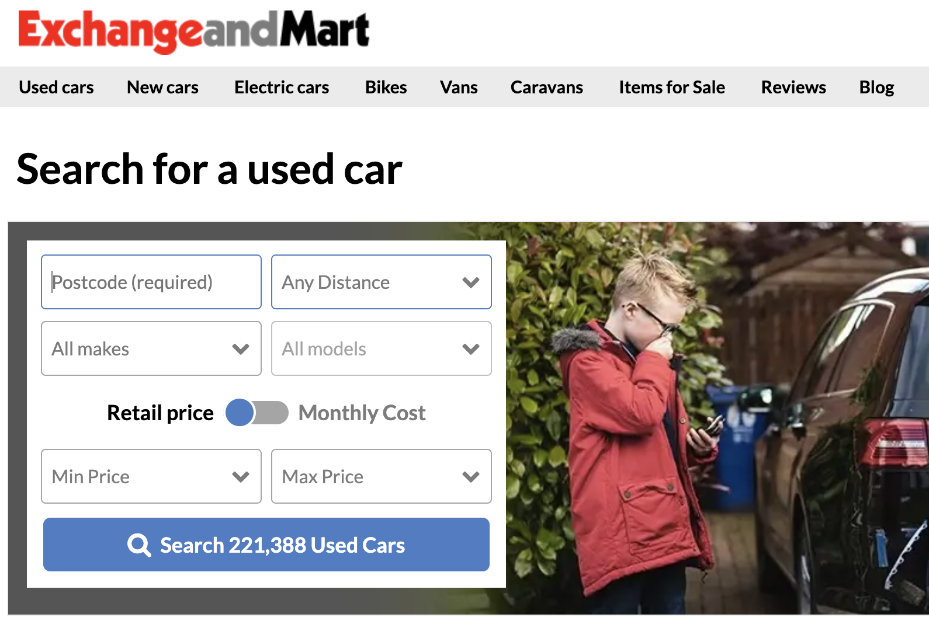
1 - Intro
Background
To know the fair price of a car
Dataset from Exchange & Mart
Notes:
For the background, when a custmer buying a new car, the price is mostly determined by the manufacturer. On the other hand, when buying a used car, it's usually hard to know what a fair price is. There are a variety of features of a car like mileage, transmission, type of fuel, fuel consumption, year of manufacturing, that will influence the used car price.
In this project, I would like using Machine Learning to evaluate the price of a used car with a supervised learning method. These informaiton may help the customer to make a good decision to buy used car in fair price.
And the data I am using is from Kaggle. But the original data were collected using web scraper from an UK online car marketplace called Exchange & Mart.

Slide 4
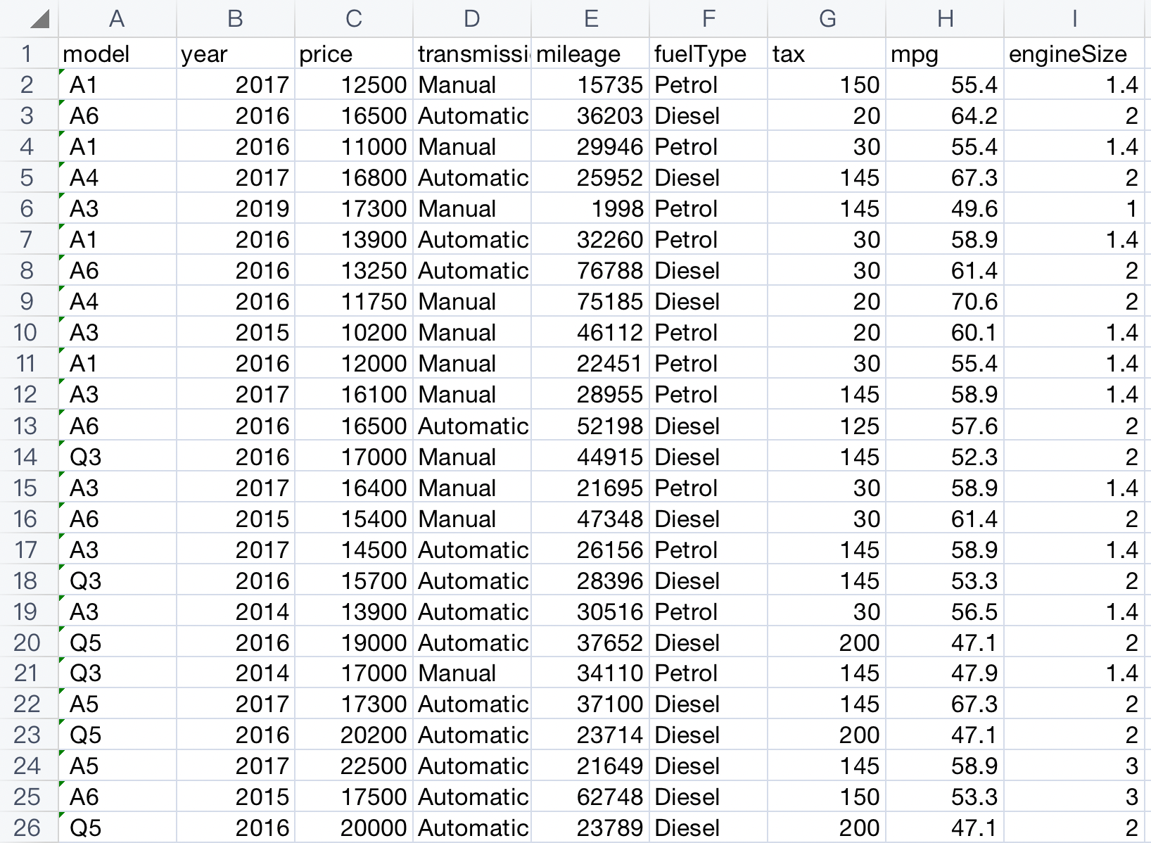
1 - Intro
Dataset
Regression Problem
Combined 6 CSV files
Add a new feature “brand”
66170 rows, 10 columns
Notes:
Because In this project, my goal is to predict a car price based on the features provided, so it is a regression problem.
The dataset come with several CSV files, each file contains 9 features of cars for one specific brand, such as toyota, ford. So after I combining all CSV files, I created another column called brand. Eventually, my dataset has 10 columns and 66170 rows.

Slide 5
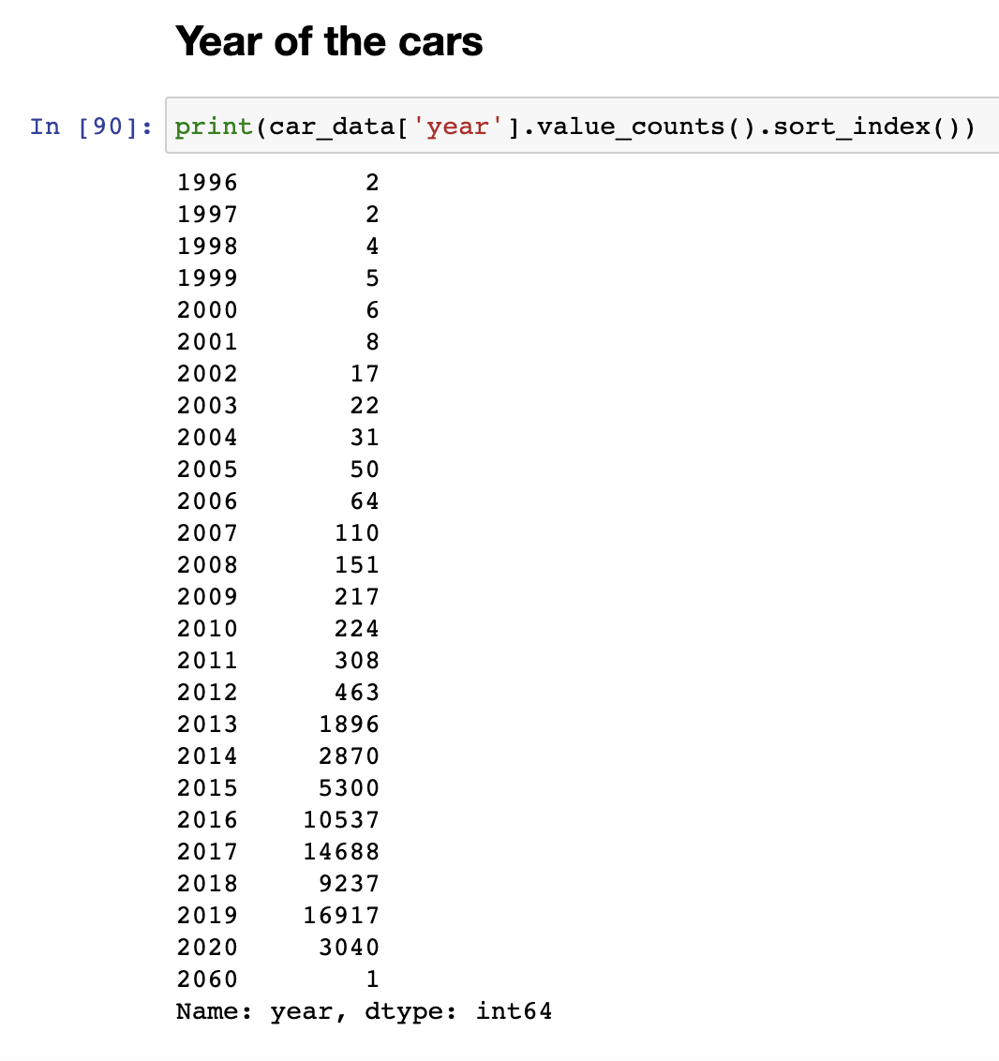
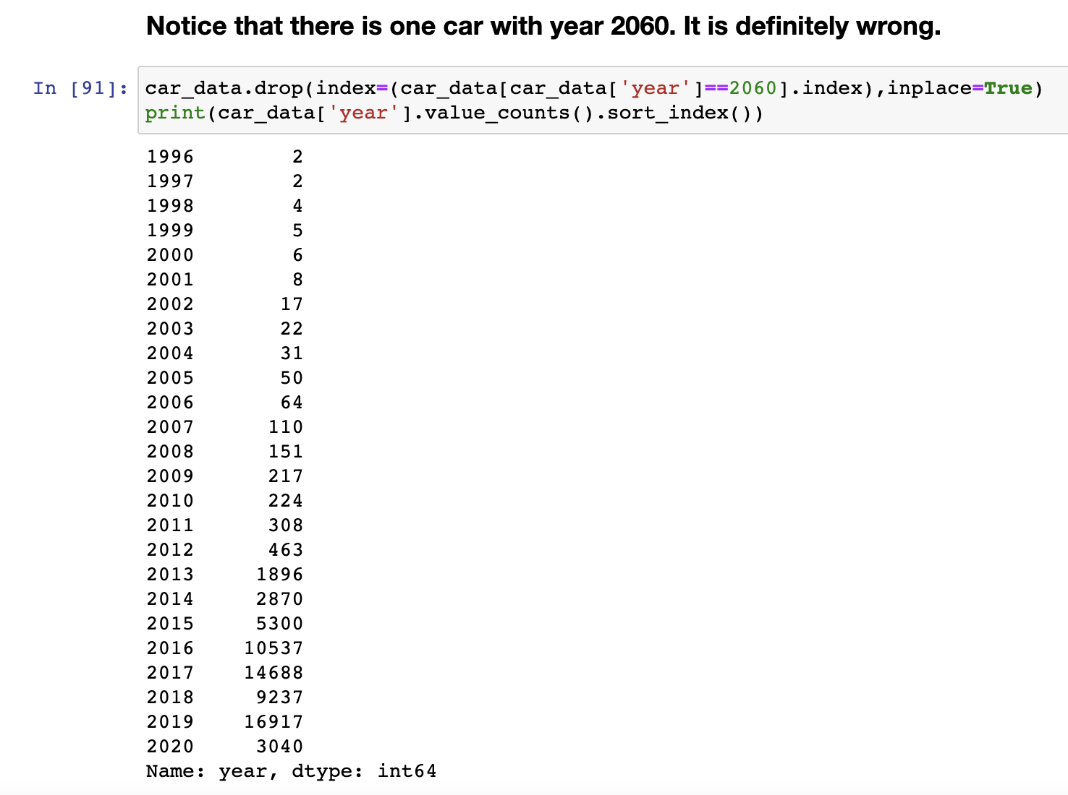
2 - EDA
Year
Notes:
After finishing combining the data, I started EDA phase. When I viewed the information about Year column in the dataset, I found that there is a car with the year of 2060. It is clearly a wrong data, so I dropped it.

Slide 6
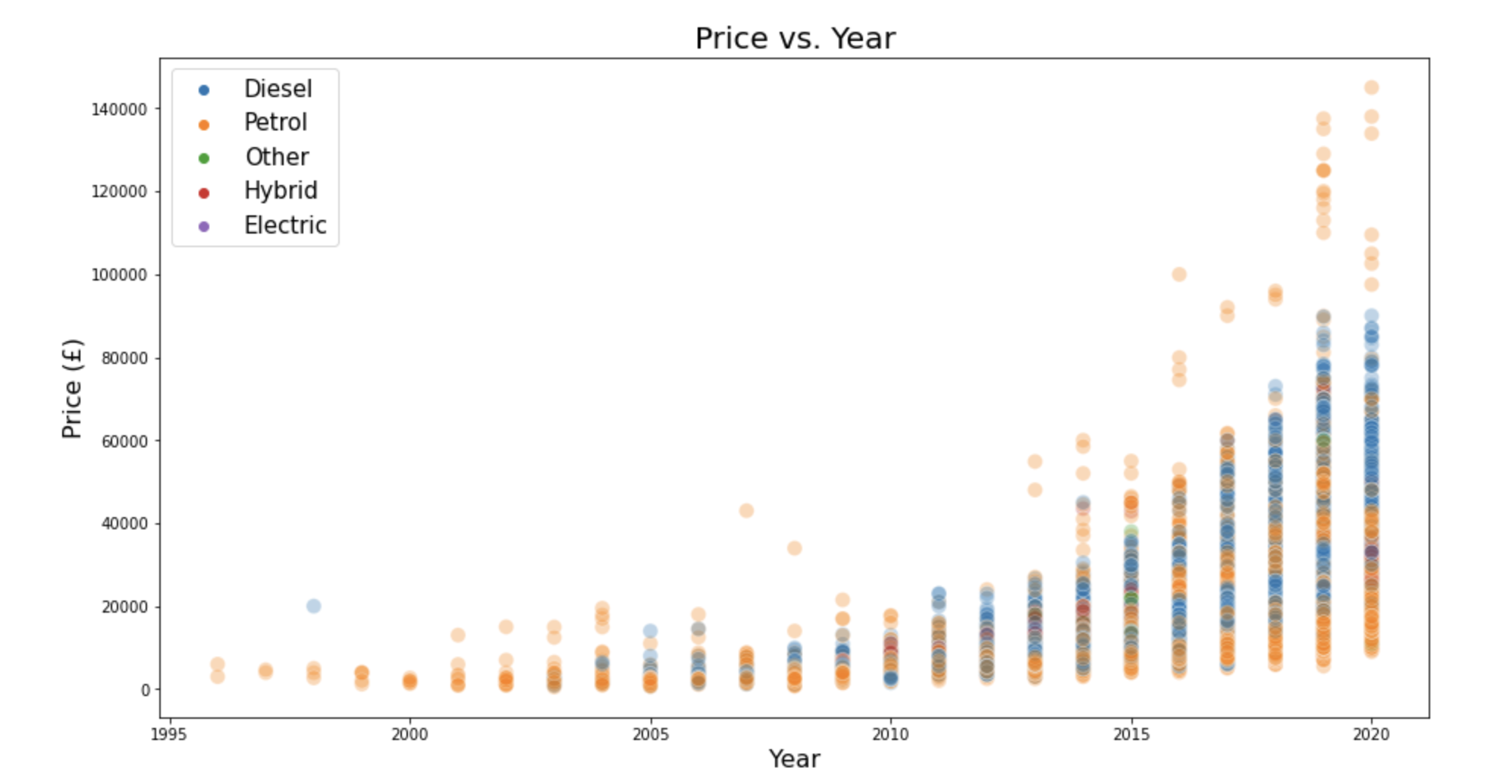
2 - EDA
Year
Notes:
Then I plotted a scatter plot of year vs price. From the figure we can learn that price are higher when the year of car closer to nowadays. The lower limit doesn’t change much, but upper limit increased obviously.

Slide 7
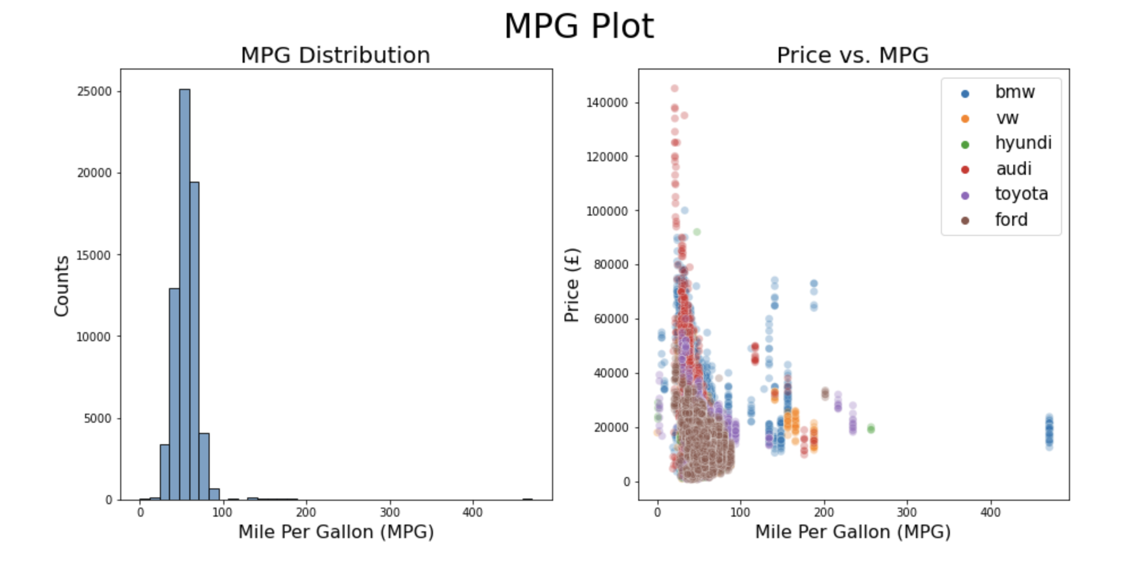
2 - EDA
MPG
Notes:
There is another EDA plot, it is about MPG feature (Mile per gallon). As we can see from the figure, most of cars have MPG around 50-60. This MPG number is from manufacturer’s specification, not reall driving result. There are few blue dots with MPG over 400 from BMW. I also check these dots, they are BMW I-3 model, which is a hybrid car.

Slide 8
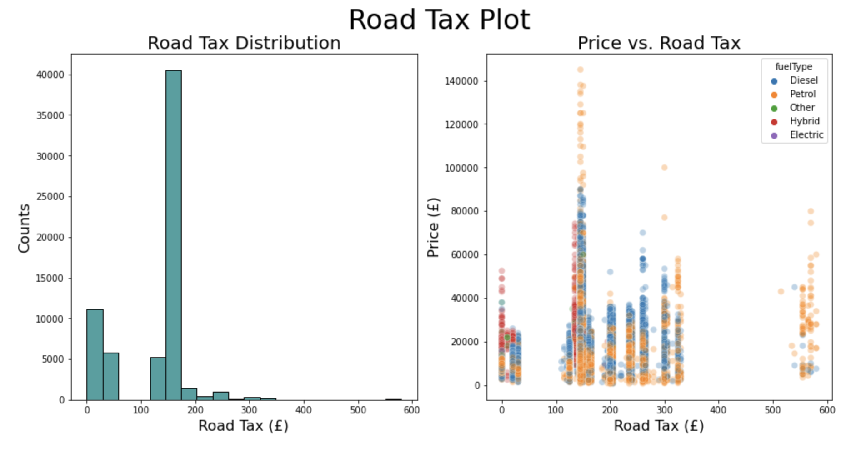
2 - EDA
Road Tax
Notes:
The column of road tax was originally called tax, which made me confused because I firstly considered it as sale tax. If it the sale tax, the tax should has positive correlation with price, but from the figure, it is apperantly not. So I did some research online and fount this is road tax in UK ,and rates are based either on engine size, or fuel type and carbon dioxide (CO2 emissions), depending on when the vehicle was first registered.. Therefore, I changed column name to road tax for better understanding.

Slide 9
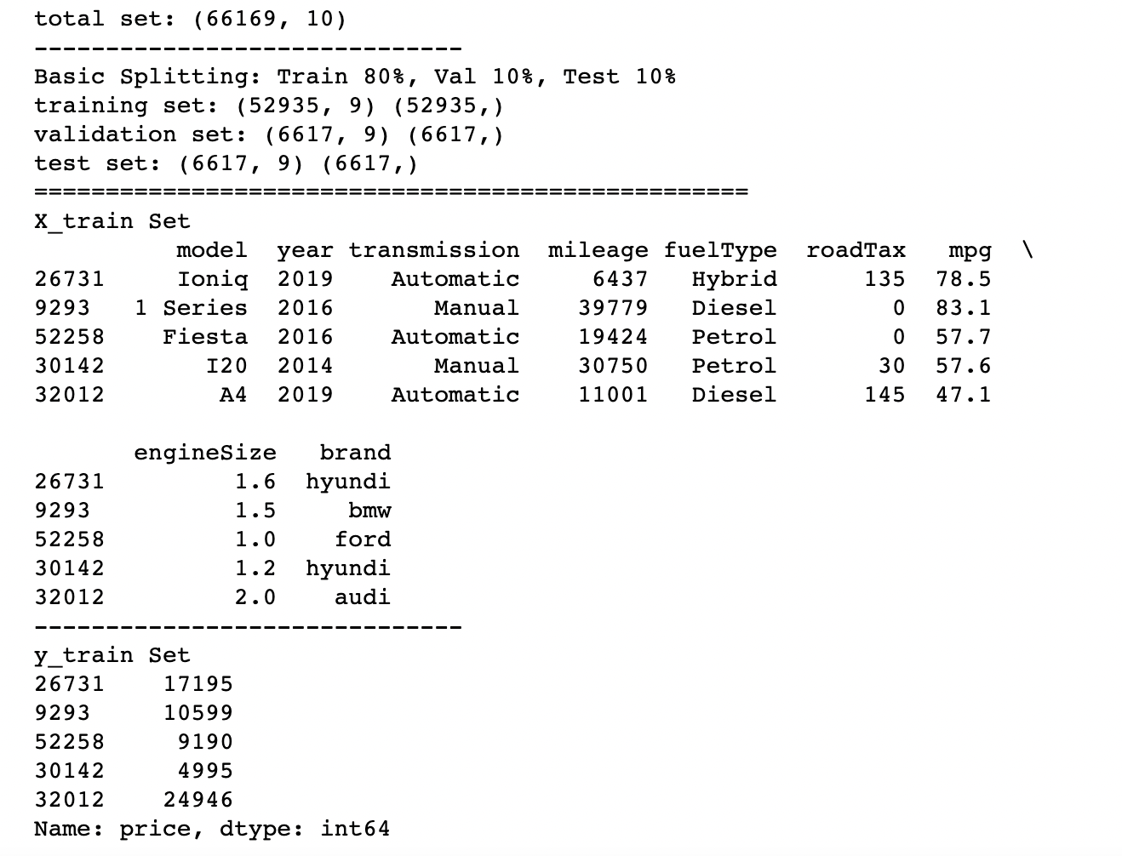
3 - Splitting
Basic Splitting
I.I.D. data
80% train
10% validation
10% test
Notes:
After EDA, I started splitting process. In this case, I just used basic splitting method because of iid data I have. Since I have dataset with about 66K rows, I splitted it in 80%-10%-10% way, which means train set including 80% of total data, and valiadation set and test set containing 10% of total data, respectively.

Slide 10
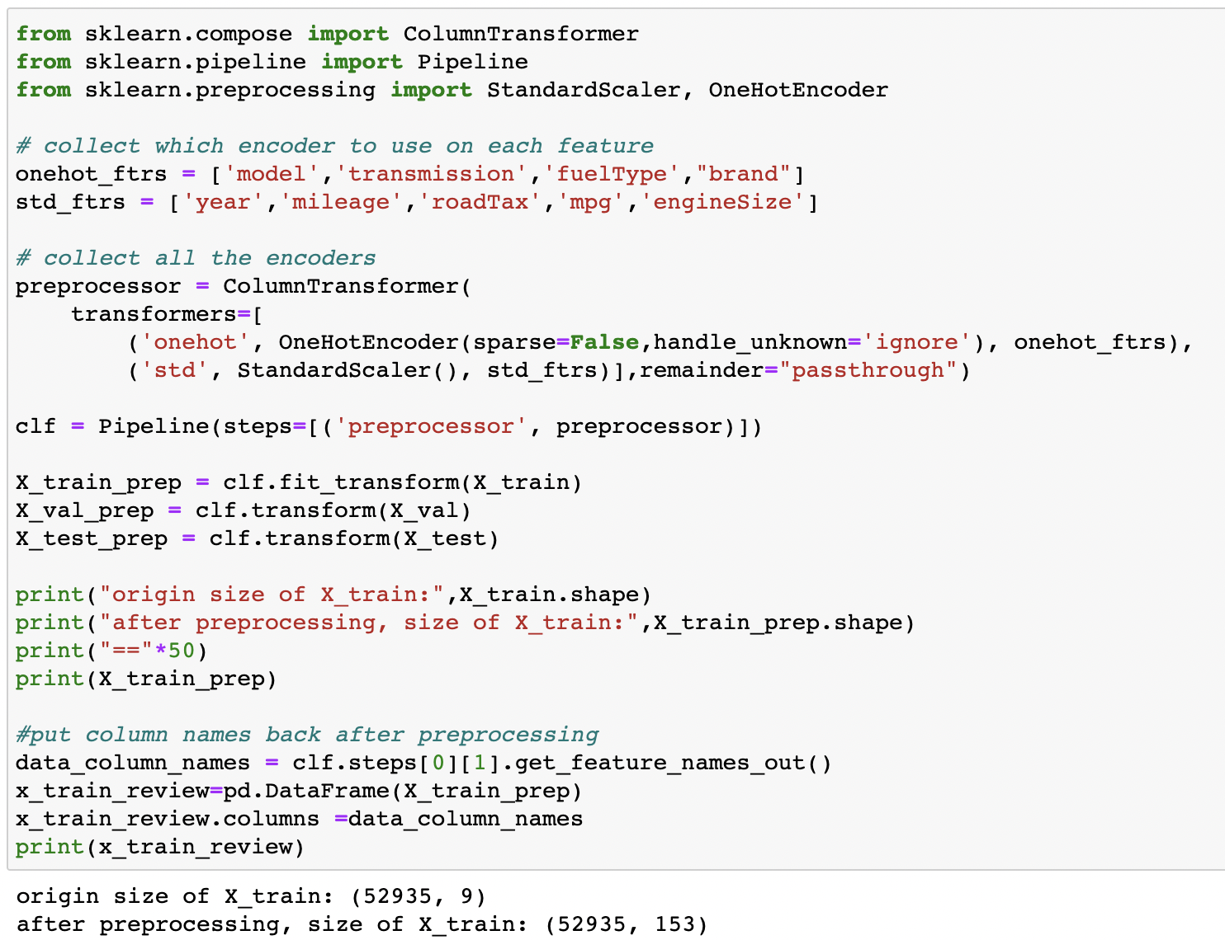
3 - Preprocessing
OneHotEncoder for str
StandardScaler for int
Prep through pipeline
Columns before prep: 10 Columns after prep: 153
Notes:
When spitting was finished, I entered preprocessing phase. Here, I used one hot encoder for string types, like model, transmission, fueltype and brand columns. And for columns with integer type, I used standard scaler. Also, I check my dataset, there is no missing value. I built a pipeline to do the preprocessing.
Before the preprocessing, the nubmer column for data was 10, after preprocessing, the number of column became 153 because I have 134 car models.

Slide 11
To be continued
Notes:
this is the progress I have for now. thats it for my presentation. Thank you for listening.

